Slide 1
Specific Heat Capacity

Slide 2

In this Smart Lesson you will learn to:
Define specific heat capacity.
Explain the concept of proportionality in the context of specific heat.
Interpret tabulated and graphical data of heat added to a substance and its subsequent temperature change.
Solve problems involving specific heat capacity.

Slide 3
What is specific heat capacity?
The specific heat capacity of a substance is the energy required to raise the temperature of a unit mass of it by a degree.
The SI unit of specific heat capacity is joule per kilogram per Kelvin (J kg⁻¹K⁻¹) or joule per kilogram per degree Celsius (J kg^{−1∘}C⁻¹).
For practical measurements in the lab, we often use units of joules per gram per degree Celsius (J g^{−1∘}C⁻¹).
This is only valid when there is no phase change taking place. The specific heat capacity is different for every substance, because it is related to the physical and chemical structure.

Slide 4
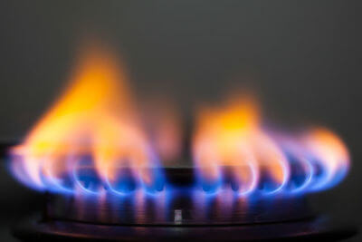
If one substance has a low specific heat capacity, it will heat up or cool down more quickly than a substance with a high specific heat capacity.
This is because less energy is needed for the same change in temperature.

Slide 5
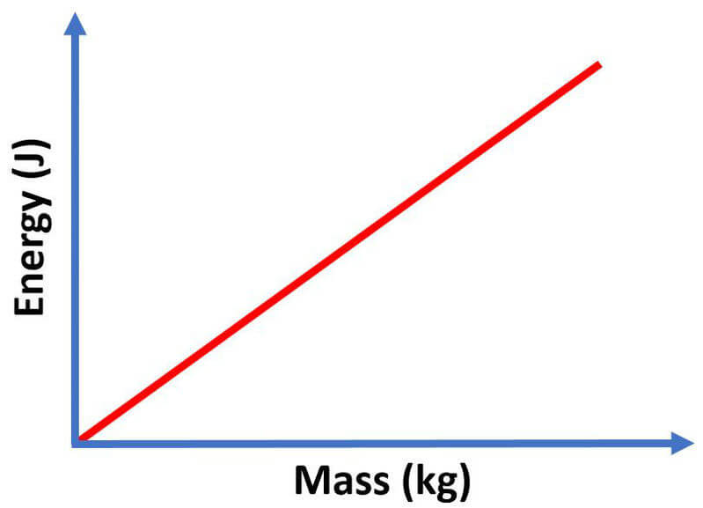
If the specific heat capacity is the energy required to heat one mass unit by one degree, what happens if you increase the mass?
If you double the mass, you will need twice as much energy to heat the substance by one degree.
If you triple the mass, you will need three times as much energy to raise the temperature by one degree and so on.
As mass increases, the energy required to heat the substance by one degree increases proportionally.

Slide 6
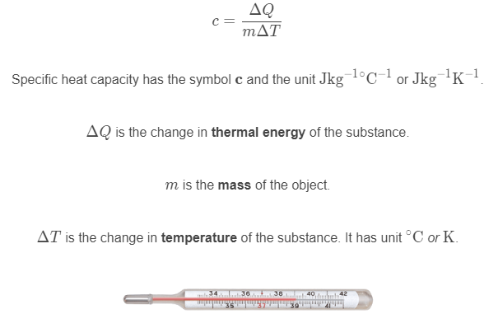
Specific heat capacity can be found by the following formula:

Slide 7
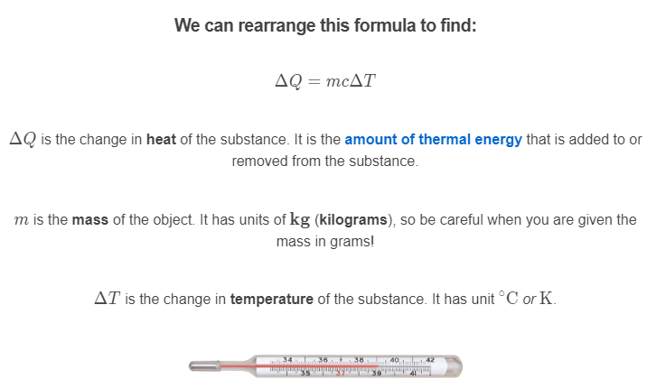

Slide 8
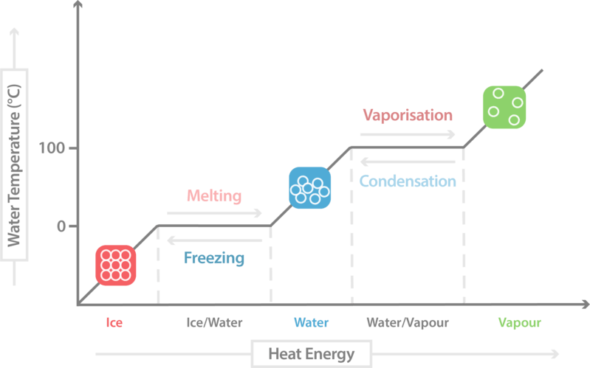
A heating curve shows the temperature of a substance as it is heated over time.
The temperature generally increases steadily as energy is added to the system, however, during a change of state, the energy is used to break bonds, so a temperature rise is not observed.
The graph below shows an ideal heating curve:

